Slide 1
Introduction to Recurrent Neural Networks
By
Dr. T. Hitendra Sarma
Associate Professor, Vasavi College of Engineering, Hyderabad

Slide 2
Topics
Recurrent neural networks (or RNN): Introduction
Sequence data - Examples
Basic architecture
Backpropagation through time (BPTT)
Types of RNNs
Applications.

Slide 3
RNN - Introduction
Recurrent neural networks or RNNs are a family of neural networks for processing sequential data.
Convolutional network is a neural network that is specialized for processing a grid of values X such as an image, whereas a recurrent neural network is a neural network that is specialized for processing a sequence of values x (1) , . . . , x (τ) .
Just as convolutional networks can readily scale to images with large width and height, and some convolutional networks can process images of variable size, recurrent networks can scale to much longer sequences than would be practical for networks without sequence-based specialization.
Most recurrent networks can also process sequences of variable length.

Slide 4
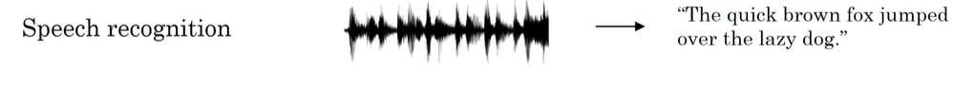
Examples of sequence data
Sequence models: one of the most exciting areas in deep learning.
Models like recurrent neural networks or RNNs have transformed speech recognition, natural language processing and other areas.
In speech recognition you are given an input audio clip X and asked to map it to a text transcript Y.
Both the input and the output here are sequence data, because X is an audio clip and so that plays out over time and Y, the output, is a sequence of words.

Slide 5
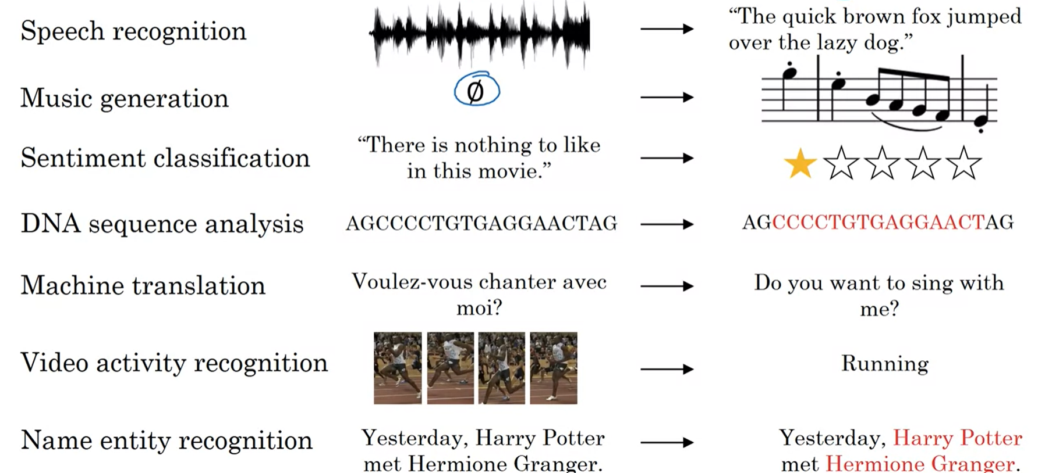
Other examples..
So all of these problems can be addressed as supervised learning with label data X, Y as the training set.
In some examples; both the input X and the output Y are sequences
Sometimes X and Y can have different lengths
Sometimes X and Y have the same length.
In some of these examples only either X or only the opposite Y is a sequence.

Slide 6
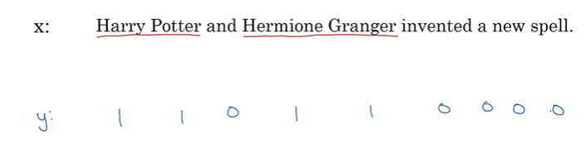
Notation
Name-entity recognition problem example:
X: Harry Potter and Hermione Granger invented a new spell.
We want a sequence model to automatically tell us where are the peoples names in this sentence.
Given this input x let's say that you want a model to operate y that has one output per input word such that for each of the input words whether it is part of a person's name or not.

Slide 7
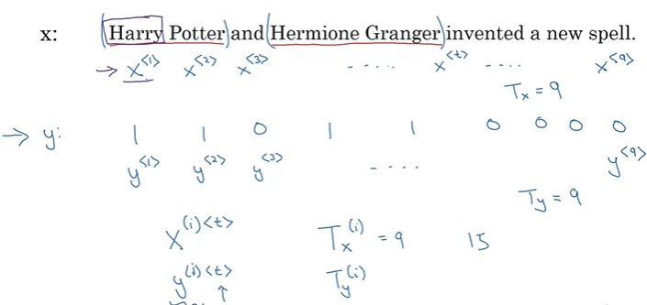
Notation…

Slide 8
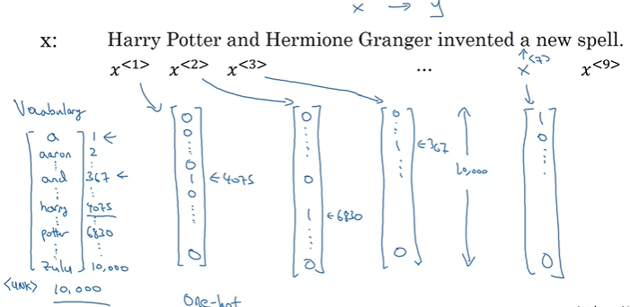
Representing Words : One-hot encoding
How to represent each word in the given input sentence.
Assume our sample dictionary has 10,000 words.

Slide 9
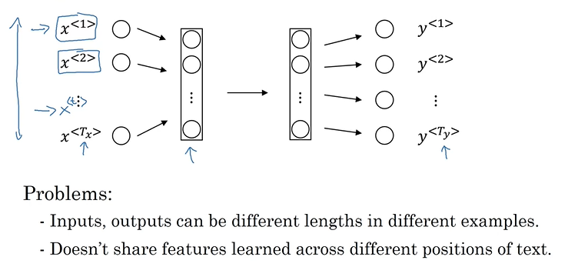
Why not a standard network?

Slide 10
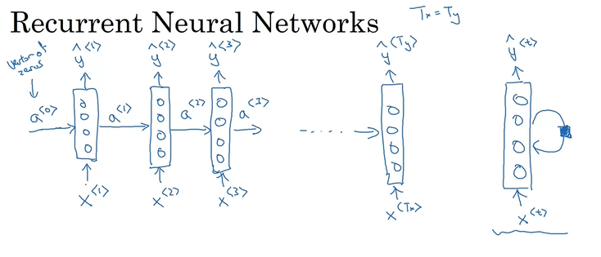
RNN Model

Slide 11
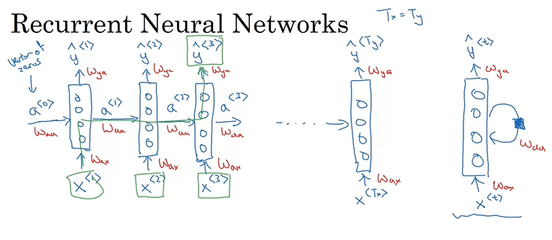
RNN Model…with parameter sharing
To predict y^^{<3>} the model takes the inputs X<2> and X<1> along with the previous parameters that are shared.

Slide 12
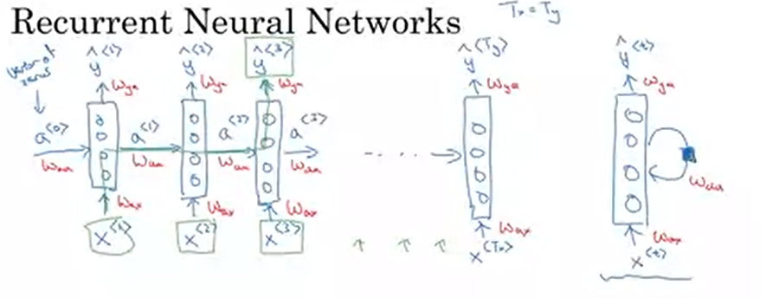
RNN Model…with parameter sharing
In some cases: To predict y^^{<3>} the model need to consider the later words in the sentence. For Example X<4> , X<5> and others.
S1: He said, “Teddy Roosevelt was a great president”
S2: He said, “Teddy bears are on sale!”

Slide 13
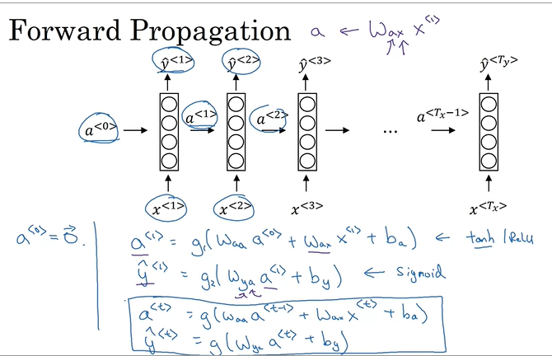
RNN Model – Forward Propagation

Slide 14
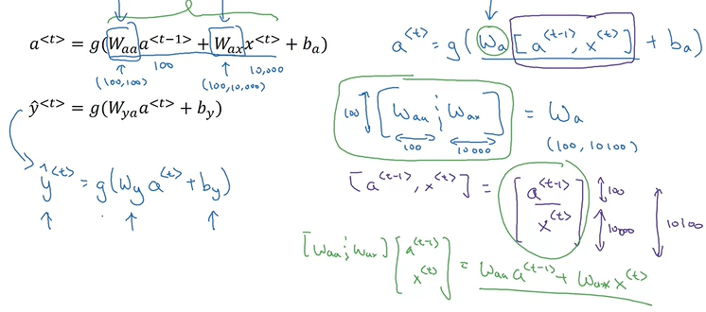
Simplified RNN notation

Slide 15
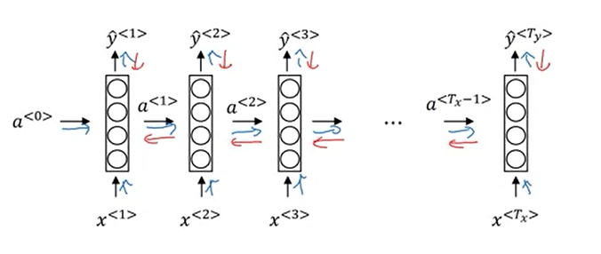
Forward propagation and backpropagation

Slide 16
Backpropagation Through Time

Slide 17
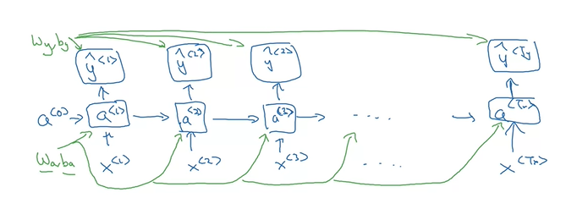
Backpropagation Through Time
Forward Propagation:

Slide 18
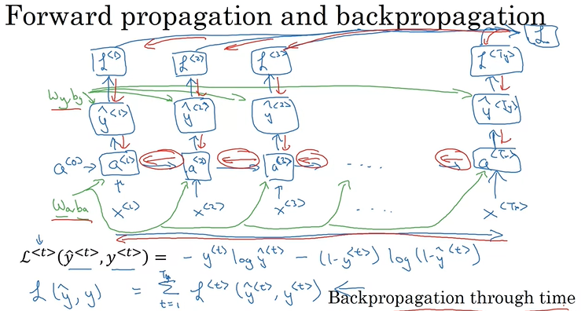
Backpropagation Through Time
Computation Graph
Standard logistic regression loss
Loss of entire sequence

Slide 19
Different Types of RNN Architectures

Slide 20
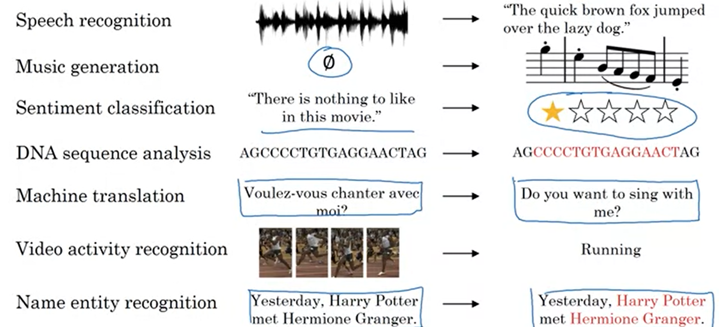
Examples of Sequence data

Slide 21
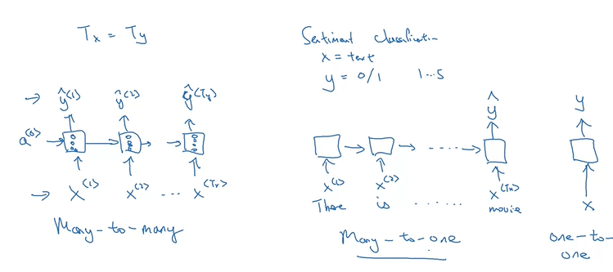
Types of RNN architectures

Slide 22
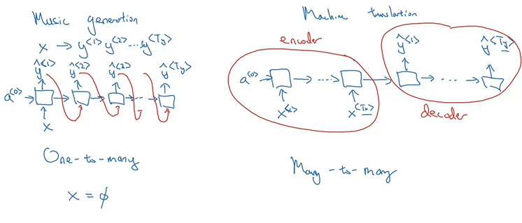
Types of RNNs

Slide 23
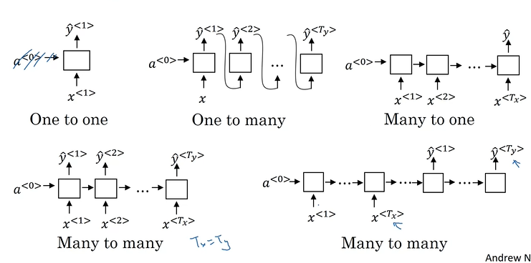
Summary of RNN architectures

Slide 24
Application
Language Model & Sequence Model Generation

Slide 25
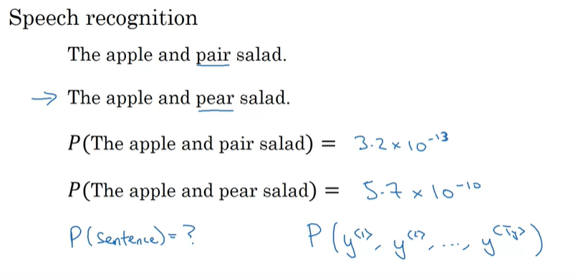
What is language modeling?

Slide 26
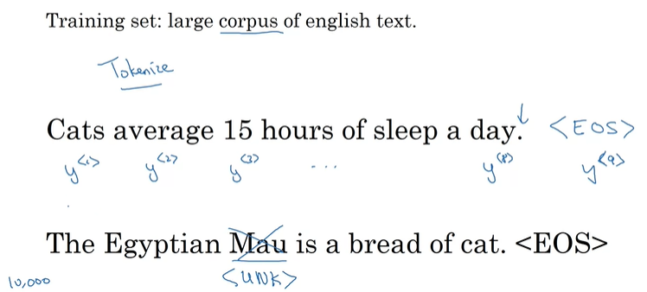
Language modeling with an RNN

Slide 27
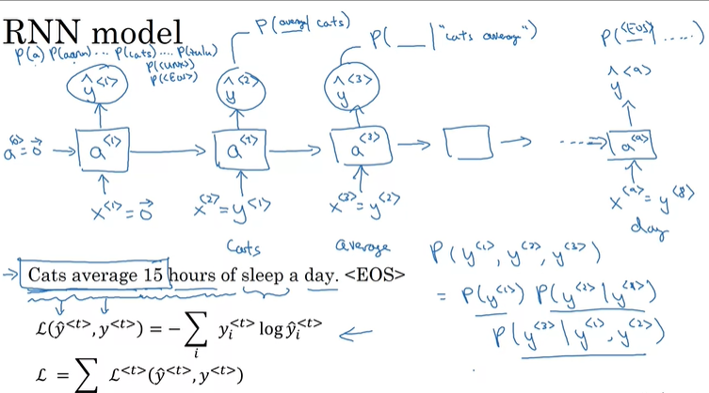
RNN Model

Slide 28
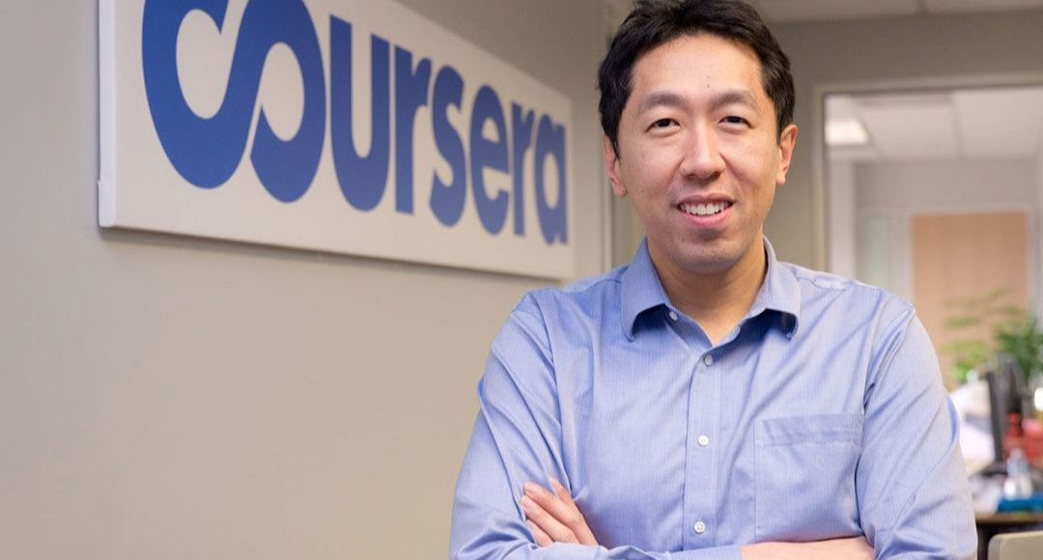
Acknowledgements
I thank Prof. Andrew Ng for providing the lecture contents for teaching through coursera.
The content in this presentation is from the lectures of Andrew Ng.

Slide 29
Further Study..
https://stanford.edu/~shervine/teaching/cs-230/cheatsheet-recurrent-neural-networks
http://web.stanford.edu/class/cs224n/slides/cs224n-2020-lecture07-fancy-rnn.pdf
http://cs231n.stanford.edu/slides/2017/cs231n_2017_lecture10.pdf
https://direct.mit.edu/neco/article/31/7/1235/8500/A-Review-of-Recurrent-Neural-Networks-LSTM-Cells
https://github.com/Kulbear/deep-learning-coursera/blob/master/Sequence%20Models/Building%20a%20Recurrent%20Neural%20Network%20-%20Step%20by%20Step%20-%20v2.ipynb

Slide 30
Questions?
You can write your questions
hitendrasarma@ieee.org
hitendrasarma@staff.vce.ac.in

